Slide 1
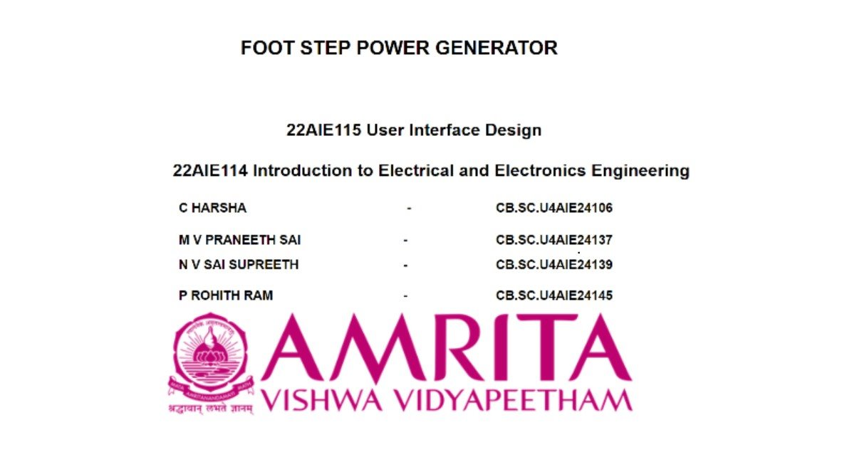

Slide 2

FOOT STEP POWER GENERATOR

Slide 3
Footstep Power Generator is a project that turns our steps into electrical energy using piezoelectric discs.
It will display us how much voltage generated and how many times we stepped on it.
This energy can be stored or used to power small devices.
INTRODUCTION​

Slide 4

OBJECTIVES
Develop a system that converts mechanical energy from footsteps into electrical power using piezoelectric discs, effectively.
Implement a sensor-based step counter to track how many times a user steps on the system.
Develop a responsive HTML-based web page to visually present step count and power generation data, accessible via mobile devices.

Slide 5
COMPONENTS
Piezoelectric disc​
Arduino uno ​
10uf capacitors​
1N4007 diodes ​
BC547 transistor​
Resistors​
LCD i2c display​
18650 cell
Led strip
HC-05 Bluetooth module

Slide 6
METHODOLOGY
When a footstep applies pressure on the platform, the piezoelectric discs get compressed.
Due to the piezoelectric effect, this sensors generate a small AC voltage.
The AC voltage generated by the piezoelectric sensors is not suitable for direct storage, so it must be converted to DC
The 1N4007 diodes allow current to flow in only one direction, ensuring proper DC conversion.
The 10µF capacitor stabilizes the DC output, preventing fluctuations.
The rectified and smoothed DC voltage is stored in 18650 lithium-ion cells.
The BC547 transistor is used for power regulation, ensuring controlled charging of the battery.

Slide 7

The Arduino Uno reads the voltage generated by the piezo sensors and stored in the 18650 battery.
Since the battery voltage might be higher than the Arduino's input range (0-5V), by using resistors we can easily bring it within safe limits.
Since the Arduino takes the measured voltage and processes it using an analog-to-digital converter.
Then it calculates the output of the power based on voltage readings as we get.
And this processed voltage and power values are sent to the LCD I2C display, which we can see it on the display.
When the energy is stored in the 18650 battery, it is used to power an LED strip.

Slide 8
To monitor the power generated and step count, we need a wireless communication module. Here, we are using the HC-05 Bluetooth module, which helps in sending data wirelessly from the Arduino to a web page.
The HC-05 module is connected to the Arduino using Tx (Transmit) and Rx (Receive) pins. The Arduino reads data from the piezoelectric sensors, calculates the voltage and step count, and sends it through Bluetooth.
A Bluetooth-enabled device like a laptop or smartphone receives this data. A web page made using HTML, JavaScript, and the Web Bluetooth API collects the information.
This web page displays the voltage and step count in real time, allowing users to see the energy produced. The system makes it easy to track power generation with each step taken

Slide 9
HC-05 Connections with Arduino-UNO:
1.VCC → Connected to 5V on Arduino
2.GND → Connected to GND on Arduino
3.TX → Connected to RX (Pin 0)
4 .RX → Connected to TX (Pin 1)
LCD-I2C module Connections with Arduino-UNO:
1. Power Pins:
VCC → Connected to 5V on Arduino
GND → Connected to GND on Arduino
2. Data Pins:
SDA (Serial Data Line) →Connected to A4 on Arduino
SCL (Serial Clock Line) → Connected to A5 on Arduino

Slide 10
REFERENCES​
Piezoelectric Energy Harvest for Wearable Devices | IEEE Conference Publication | IEEE Xplore​
Piezoelectric Based Power Generation For Portable Charging System | IEEE Conference Publication | IEEE Xplore​
https://youtu.be/YZ4OBxyyqOg?si=PlaiS7aDfRq7t1_Y​

Slide 11
Thank you​

